Slide 1
Developing a measure of Acceptance and Action towards Inter-racial Intimacy (aka Sexual Racism)
Yash Bhambhani, Maureen Flynn, Karen Kate Kellum & Kelly G. Wilson
Notes:
BA worries We don’t really know if the verbal response is actually correlated to real life, but we know its def not gonna be related if participants are not engaged. If they are not involved.
We aimed to examine – our lab something about % of responses that people fucked around or went too fast, or straightlined, and was conducted in lab – ask Solomon for results.
The purpose of this study was to examine potential methods of intervening when we assume that people were not engaging in reading behavior

Slide 2
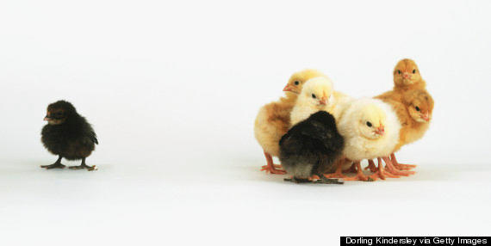

Slide 8
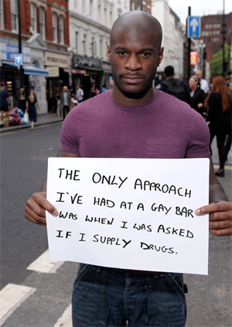
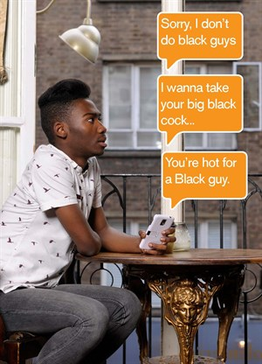

Slide 10
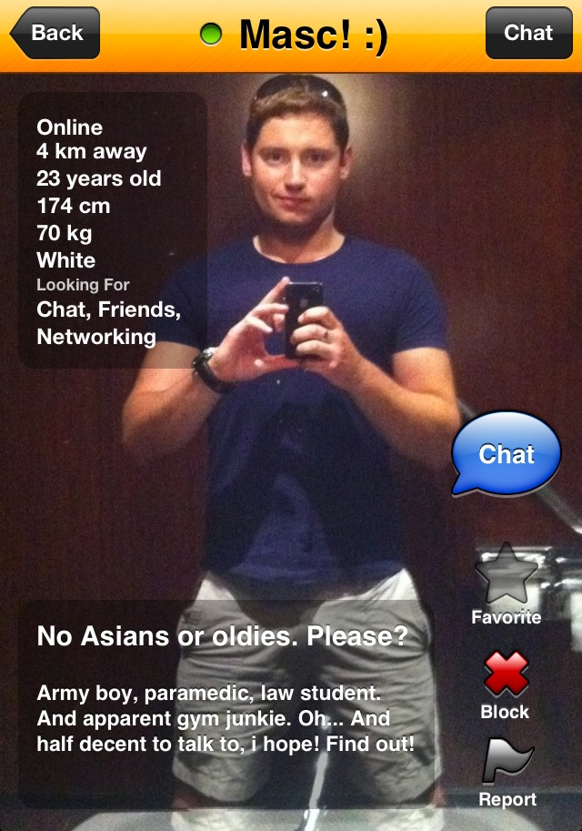

Slide 11
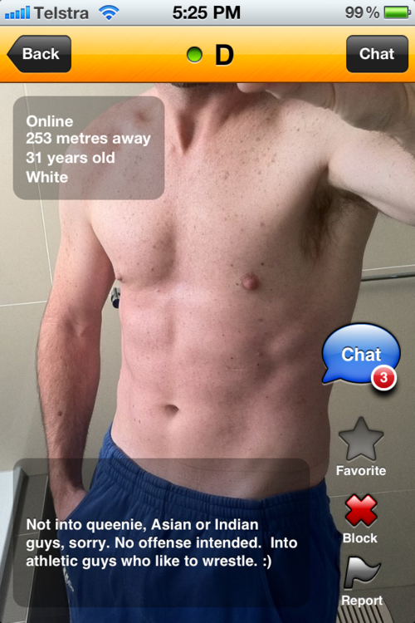

Slide 13
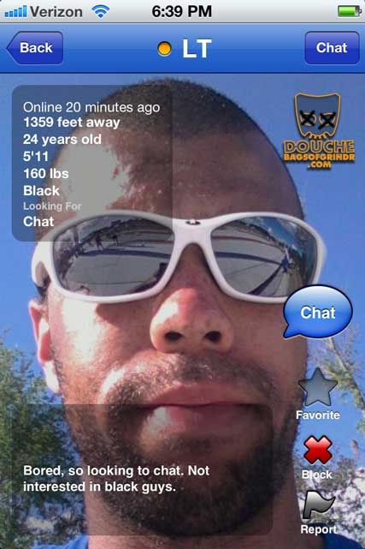

Slide 14
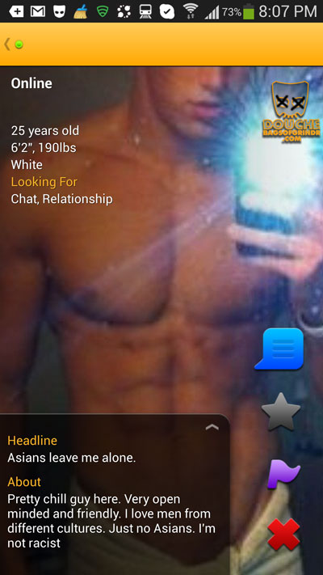

Slide 15
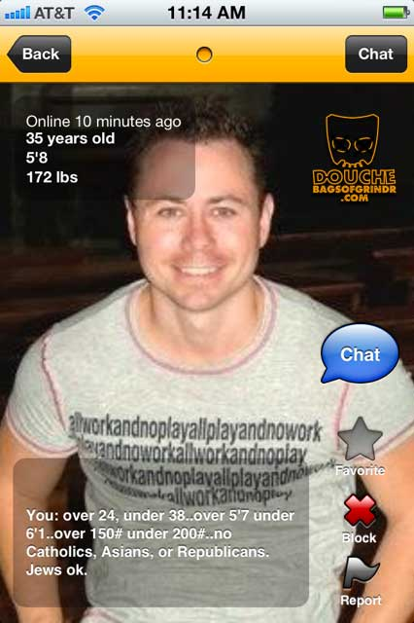

Slide 16
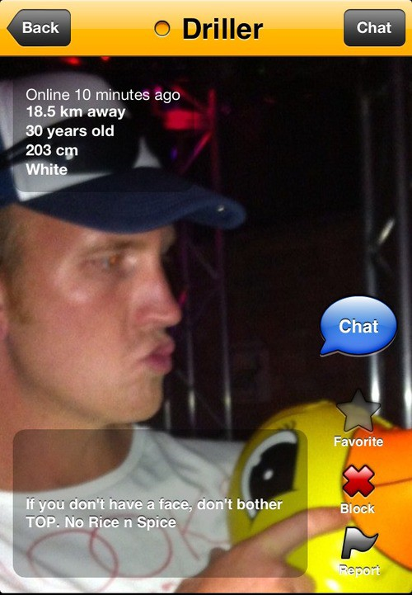

Slide 17
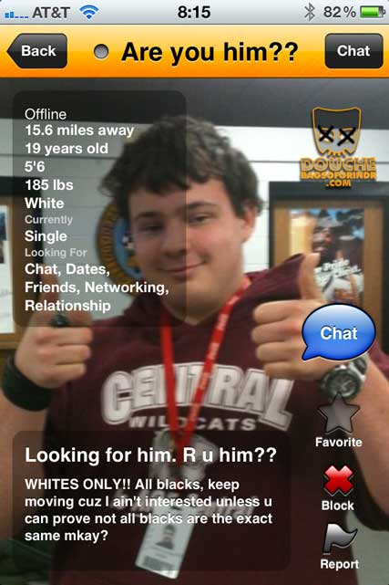

Slide 18
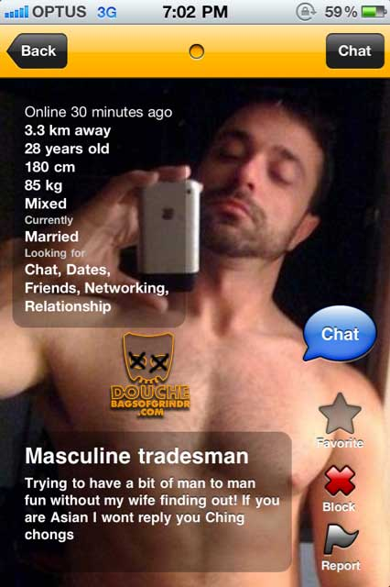

Slide 19
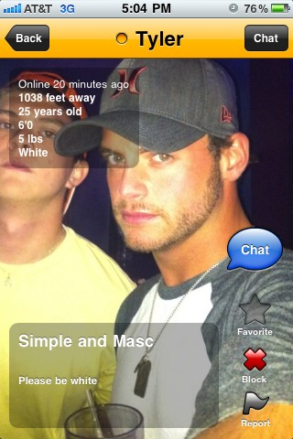

Slide 20
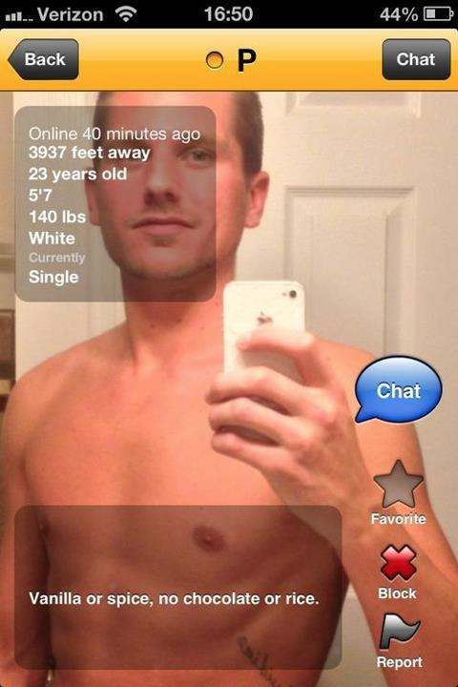

Slide 21
High
Low

Slide 22
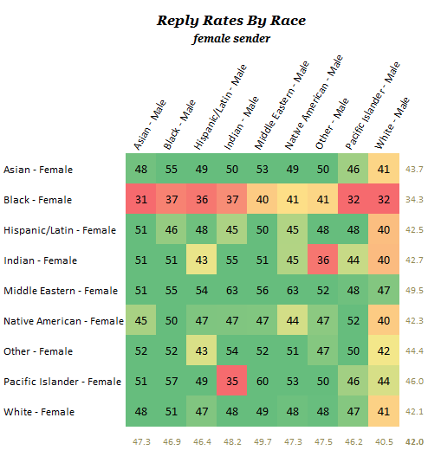
High
High
Low
Low

Slide 23
High
High
Low
Low

Slide 24
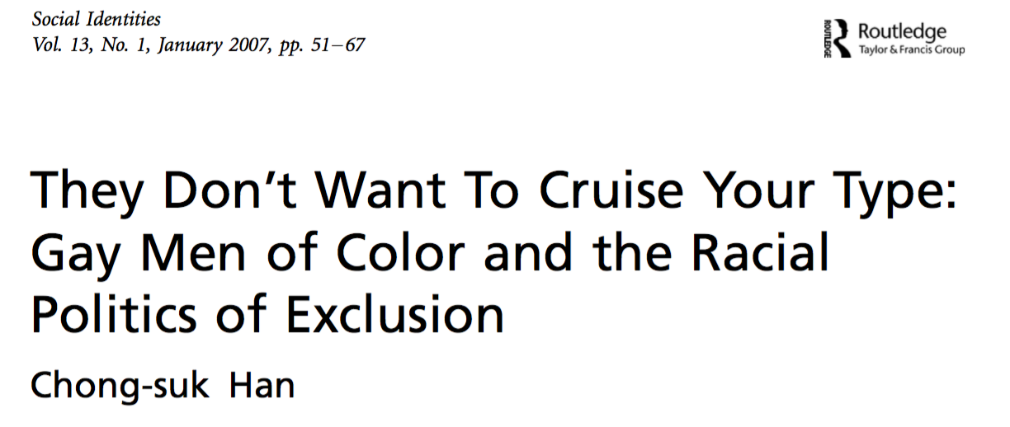
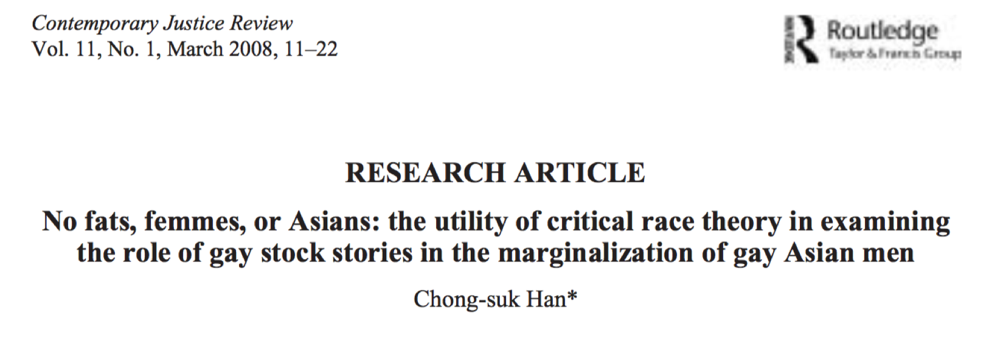

Slide 26
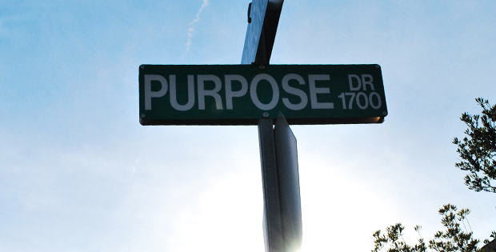
Notes:
Purpose of study – influence people’s behavior to make them more engaged with survey

Slide 27
Notes:
Methods transition

Slide 28
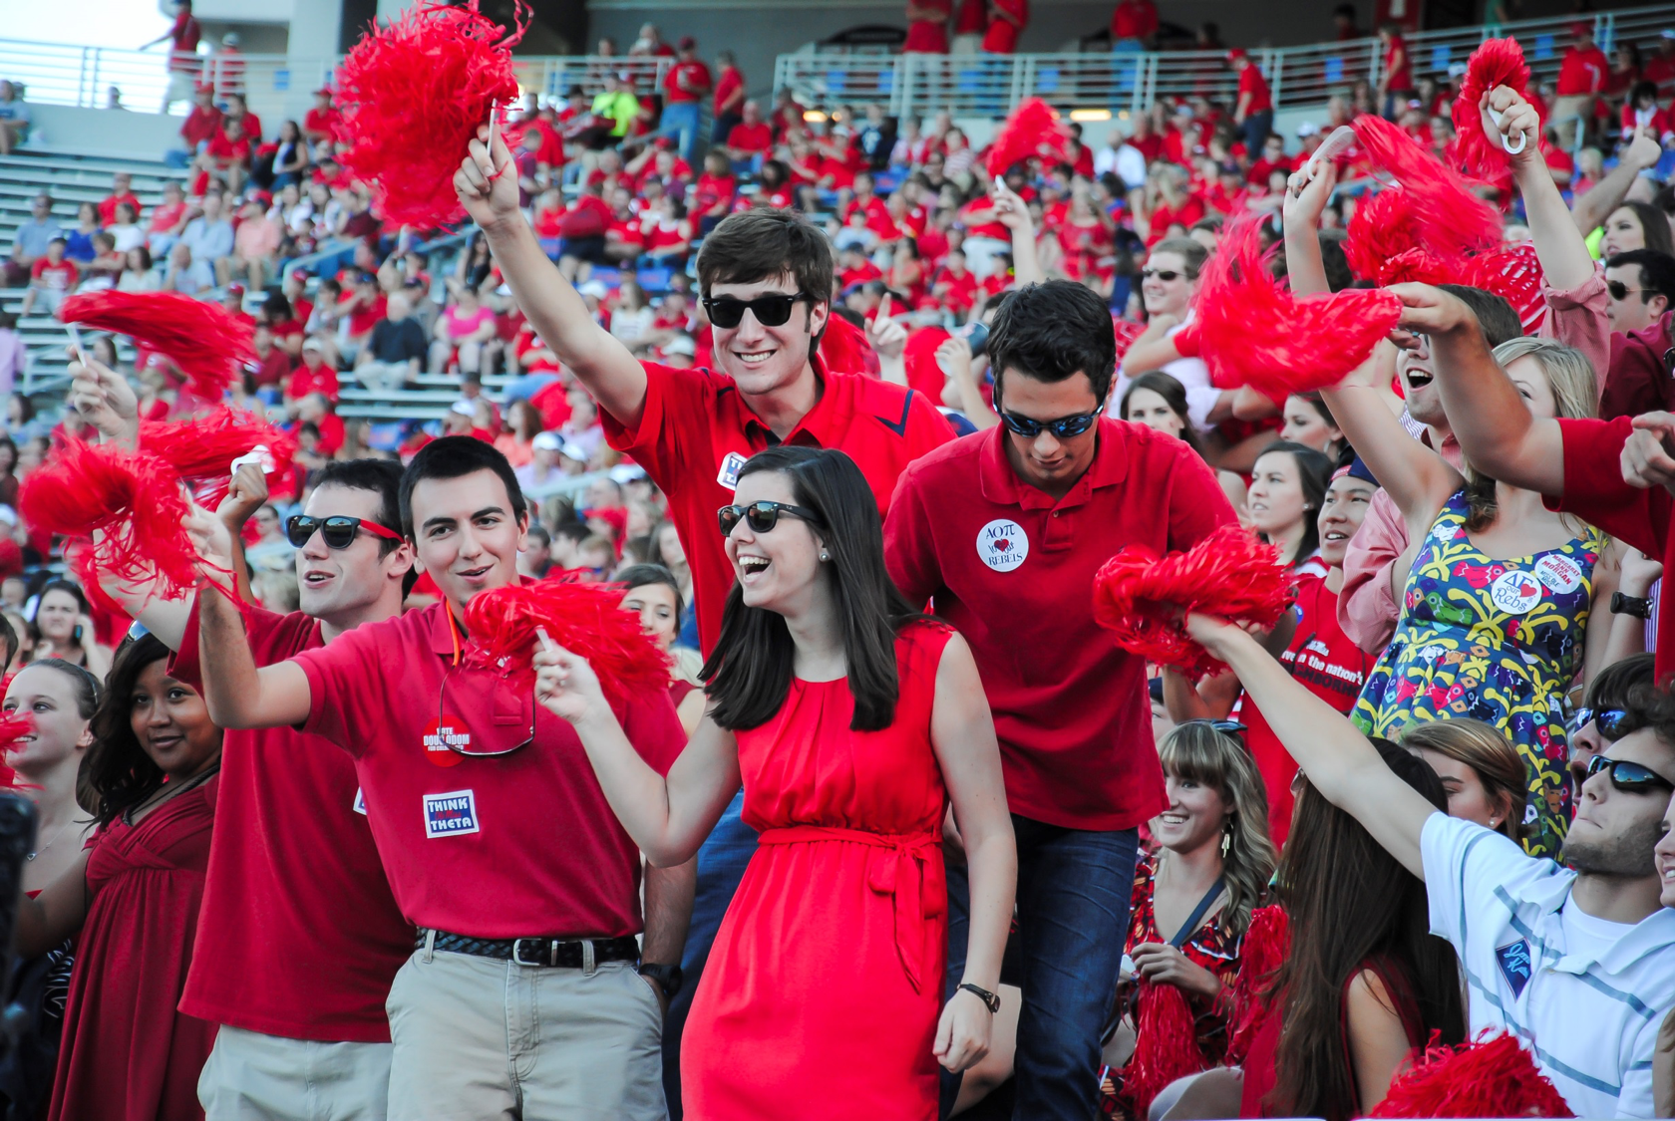
Study 1 (EFA)
N = 371
Age = 18.7 (SD = 0.7)
66% women
82% White
7% LGBT
Intro to Psych students
Qualtrics
Notes:
Completed any time, online, participant management software, surveys on qualtrics

Slide 29
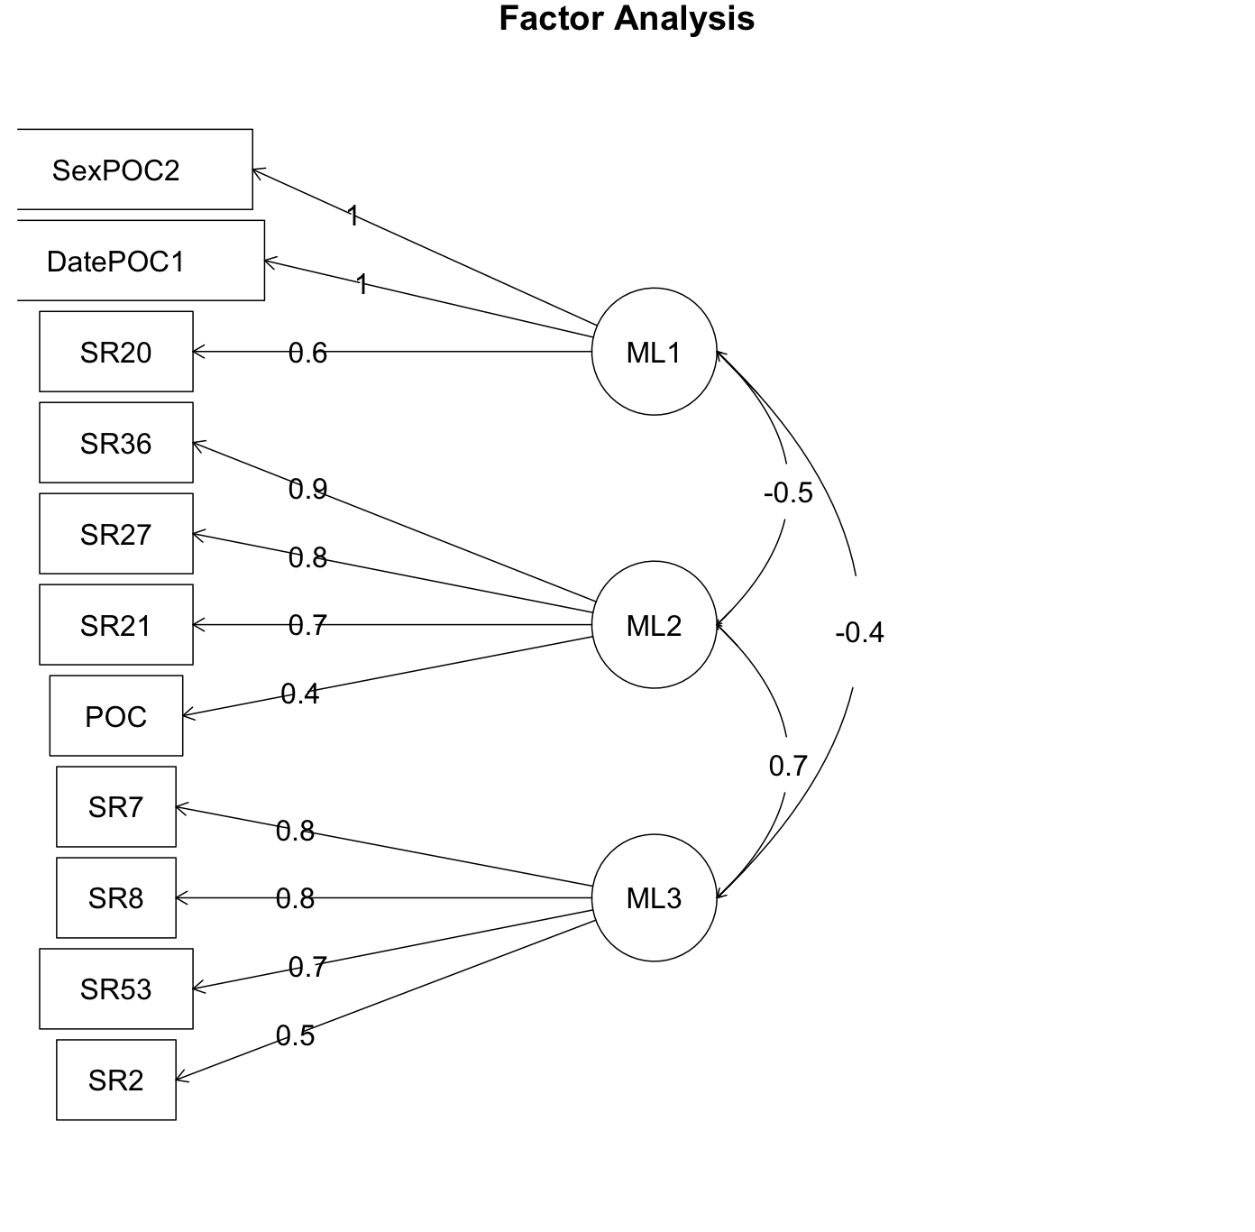
11-item
3 factors

Slide 30
Study 2 (EFA - II)
N = 379
Age = 19.5 (SD = 1.79)
70% women
77% White
8.4% LGBT
Intro to Psych students
Qualtrics
Notes:
Completed any time, online, participant management software, surveys on qualtrics

Slide 31
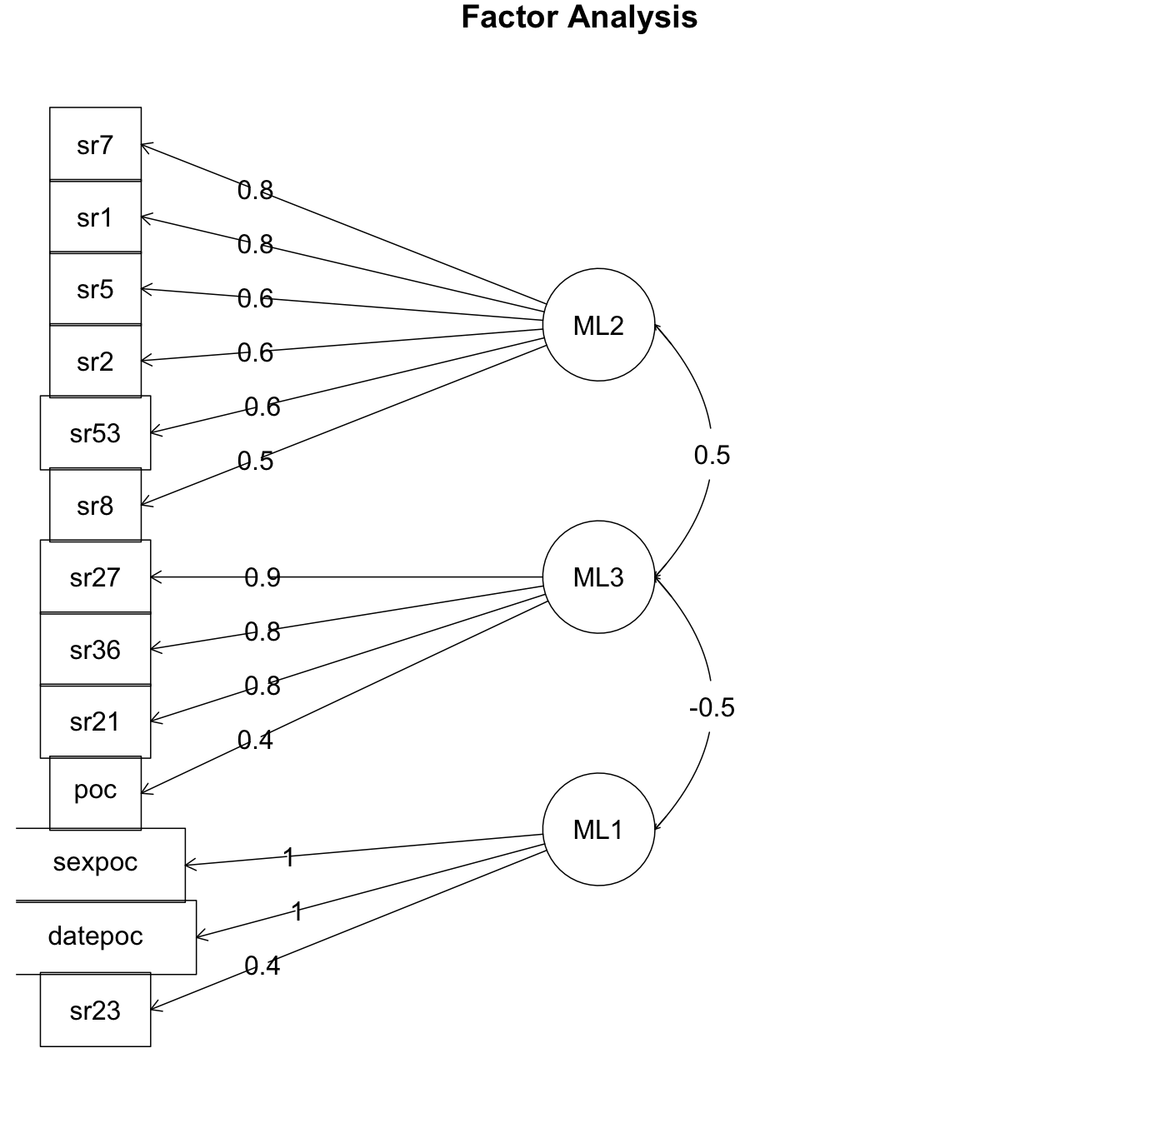
13-item
3 factors

Slide 32
Study 2 (CFA)
N = 379
Age = 19.6 (SD = 2.58)
69% women
82% White
6% LGBT
Intro to Psych students
Qualtrics
Notes:
Completed any time, online, participant management software, surveys on qualtrics

Slide 33
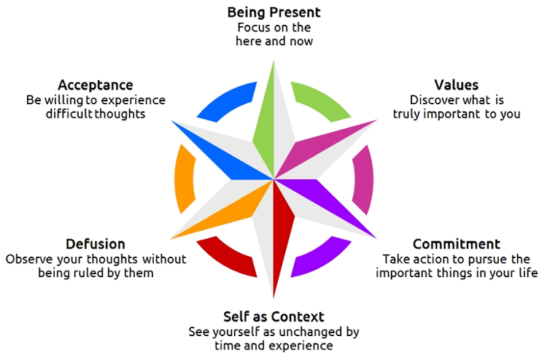
FFMQ
SCS
Acceptance and Action towards Interracial Intimacy
IRI
SDOS
AAQ-S

Slide 34
Model fit statistics
Chi-square 127.59
df 60
CFI .97
TLI .96
RMSEA .054 [.041-.067]

Slide 35
Factor 1
Attitude towards interracial Intimacy or acceptance of mentioning race preferences online
Notes:
df=60, chi-square – 127.59
CFI – 0.97, TLI – 0.96
RMSEA 0.054 [0.041-0.067]
P value RMSEA<0.05= 0.299
SRMR – 0.061

Slide 36
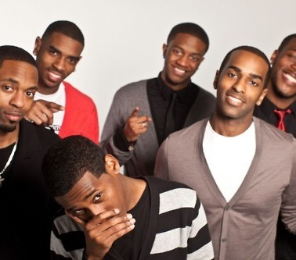
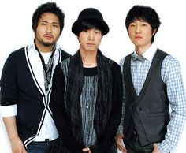
Factor 2
Desirability (or lack of) of People of Color as Intimate Partners

Slide 37
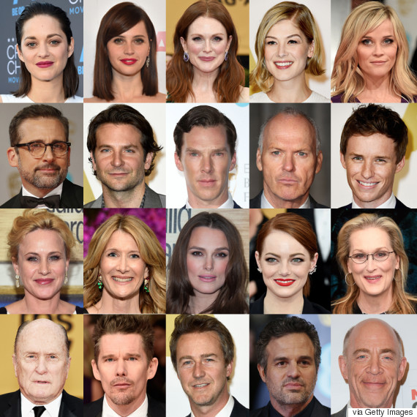
Factor 3
Whites are the most desirable
Notes:
Date/sex POC – social dominance, diversity, comfort with differences,
White privilege – psy inflex, social dominance, diversity, comfort with differences, perspective taking, empathy
Sexual racism acceptability – psy flex, diversity

Slide 38
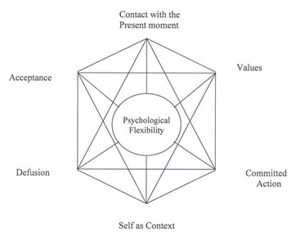
AAQ-S
psychological flexibility subscale
r = -0.30, p<0.01

Slide 39
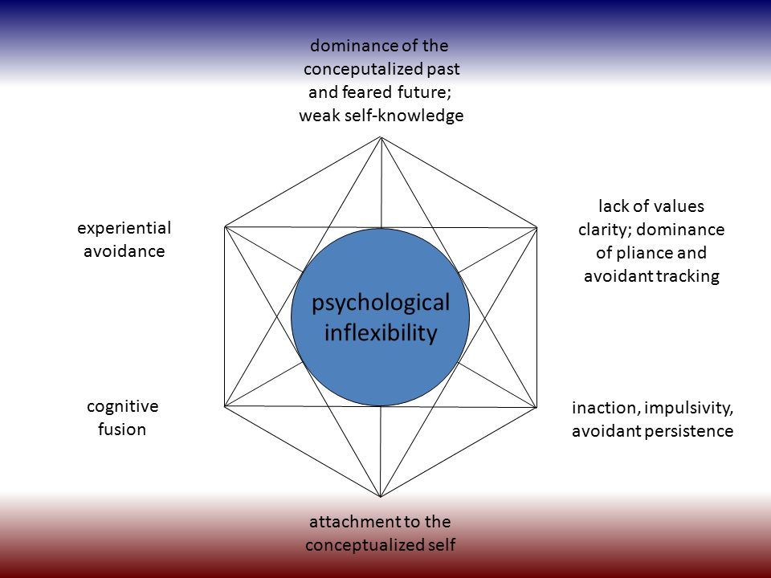
AAQ-S
psychological inflexibility subscale
r = 0.18, p<0.01

Slide 40
Social dominance Orientation (SDOS)
r = 0.30, p<0.01

Slide 41
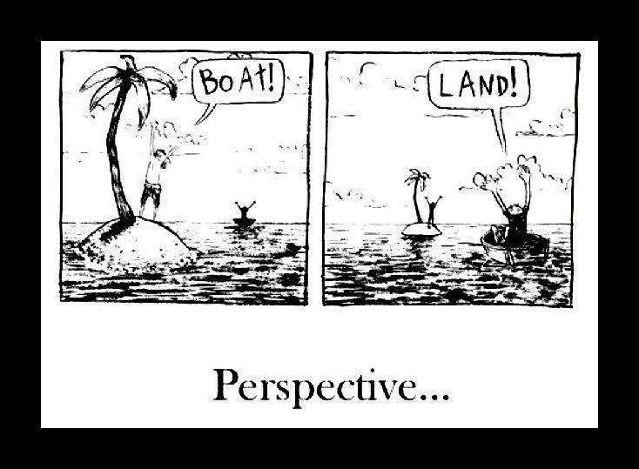
Perspective taking
r = -0.11, p<0.05

Slide 42
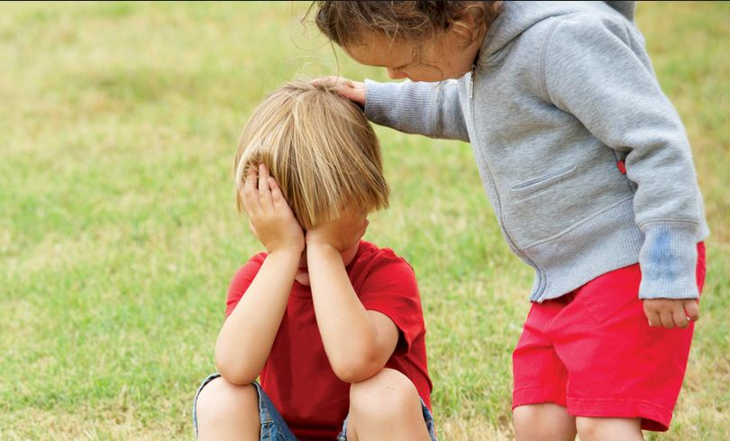
Empathy
r = -.12, p<0.05

Slide 43
Notes:
Mostly white and female – biggest prob. Need more ethnic and sexual minorities.

Slide 44
Notes:
Replicate with different populations, do interventions that decrease racism also decrease sexual racism? Put pretty picture of multiracial couple here

Slide 45
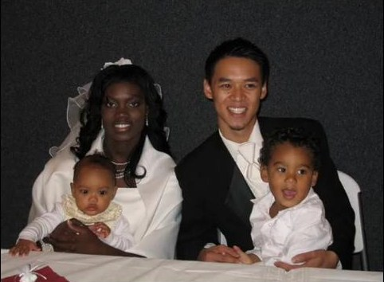
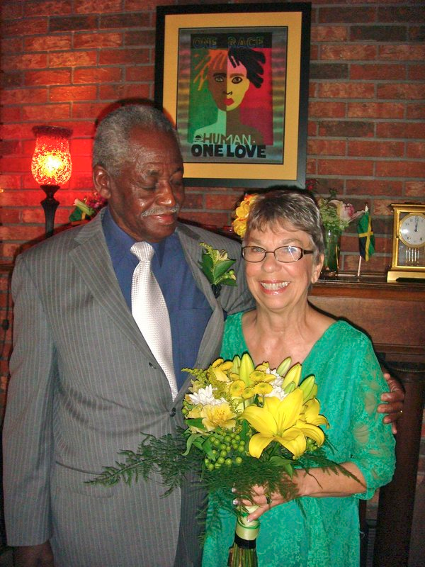
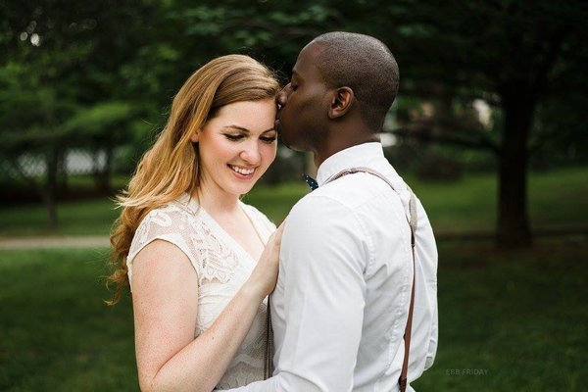
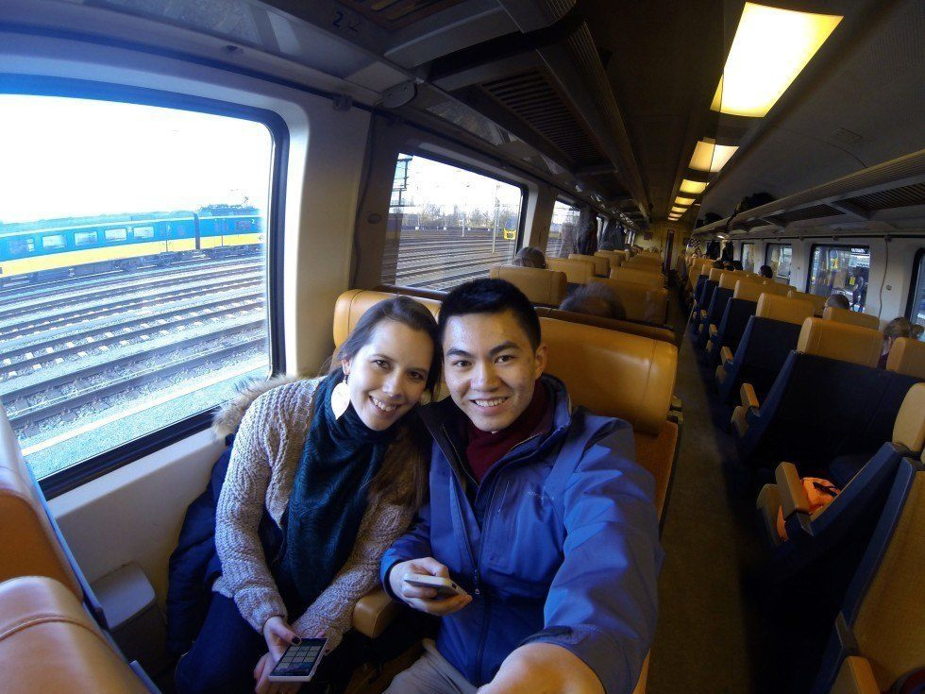

Slide 46
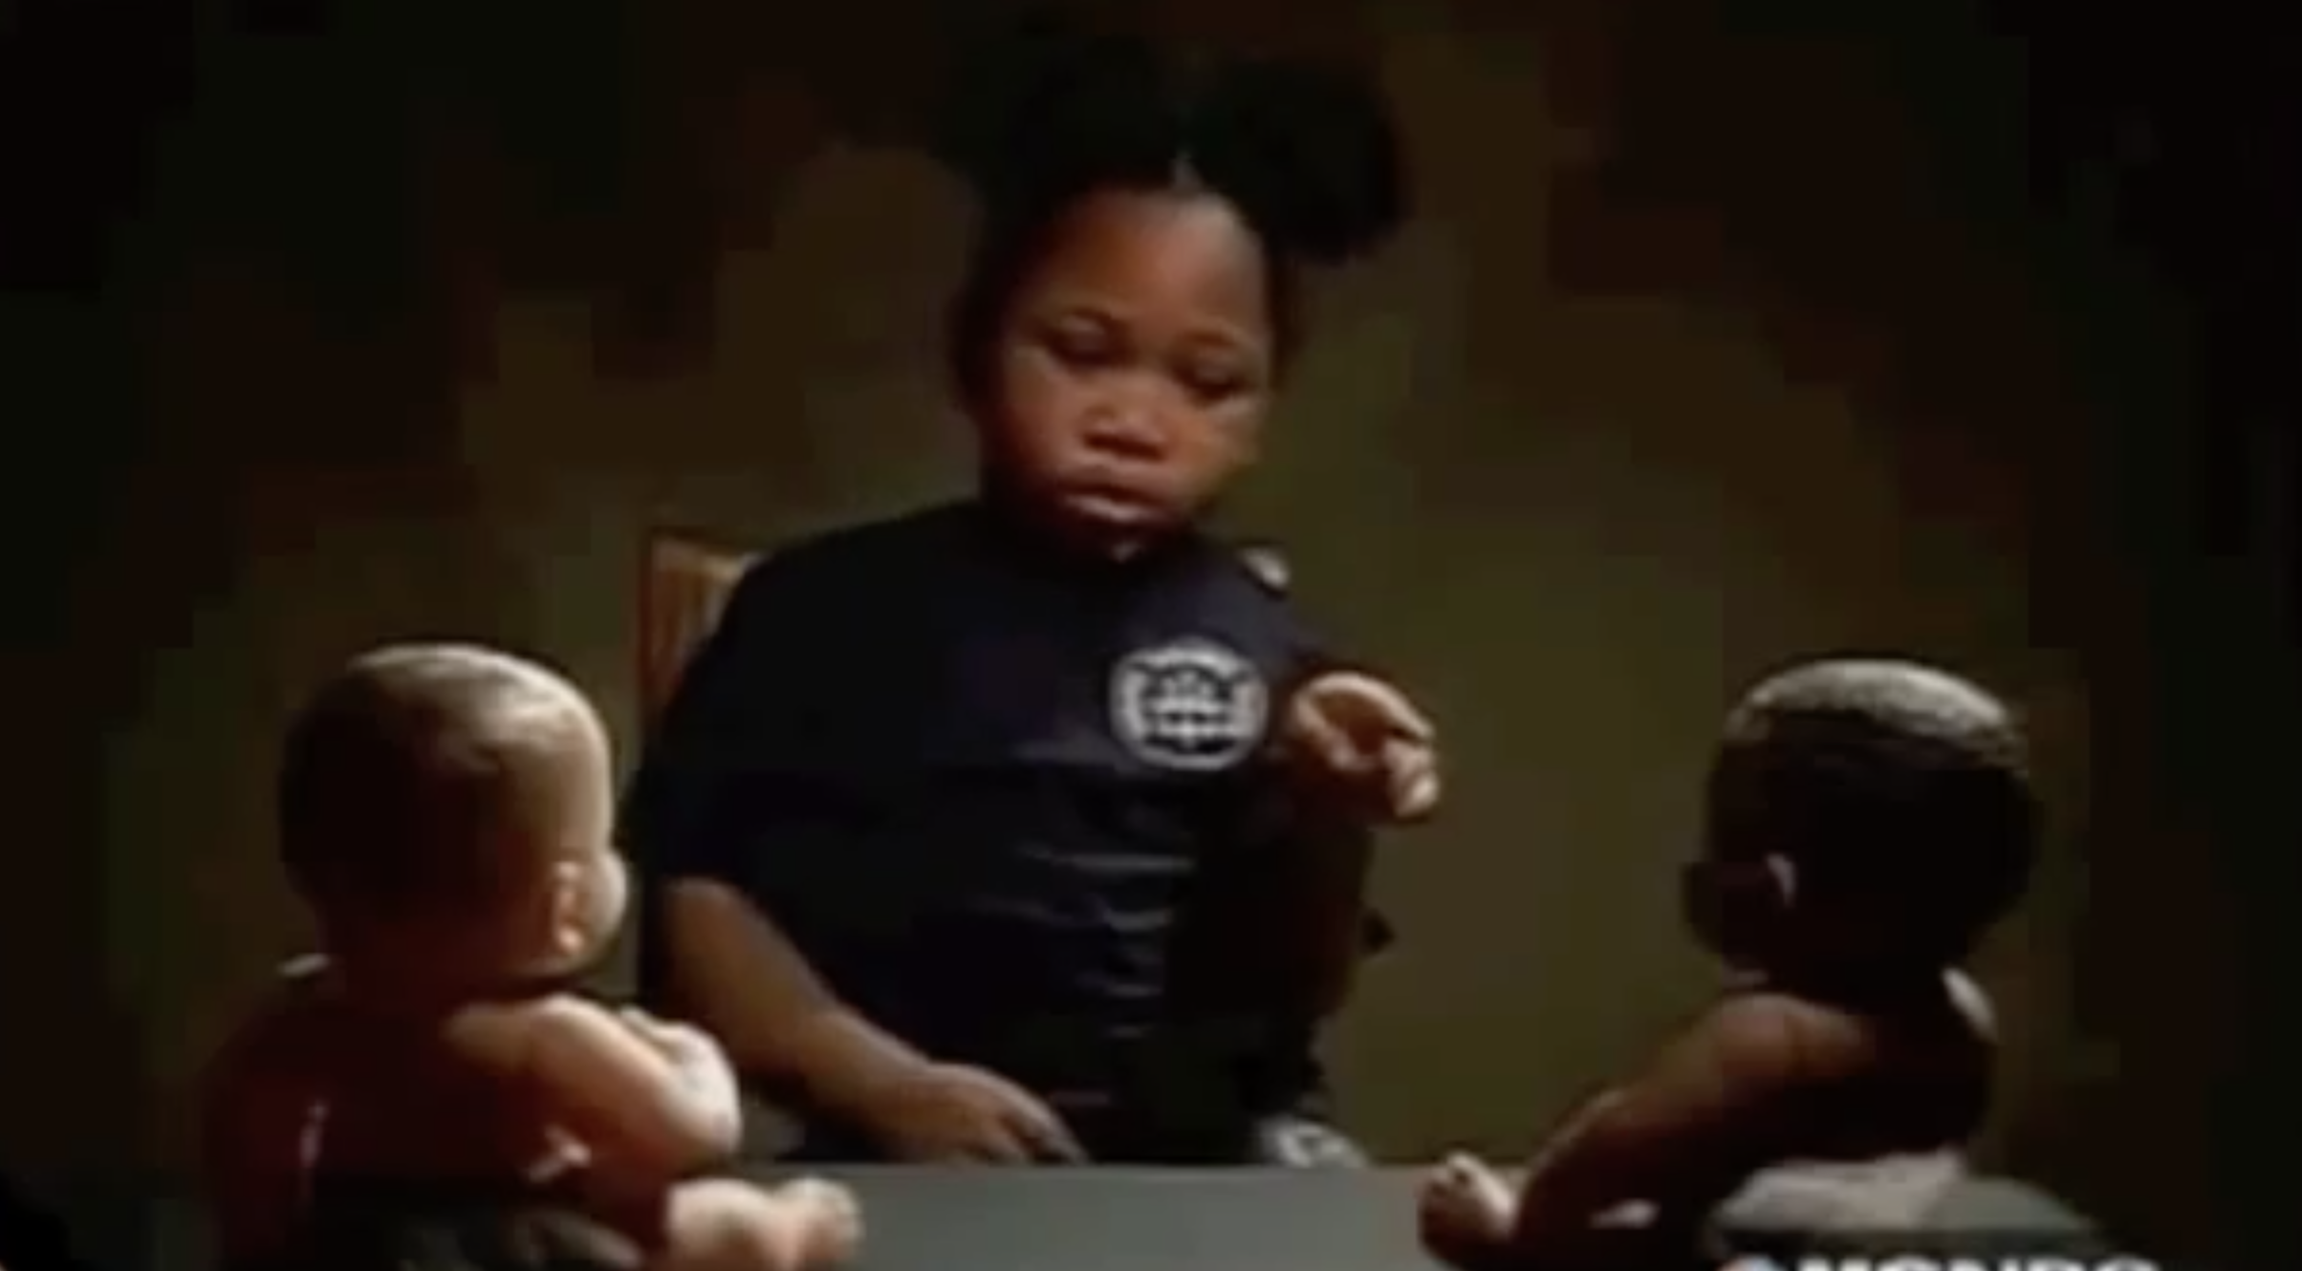

Slide 47
Interracial Intimacy or Sexual Racism measure
Yash Bhambhani, Maureen Flynn, Karen Kate Kellum & Kelly G. Wilson
Questions: ybhambha@go.olemiss.edu

